Slide 1

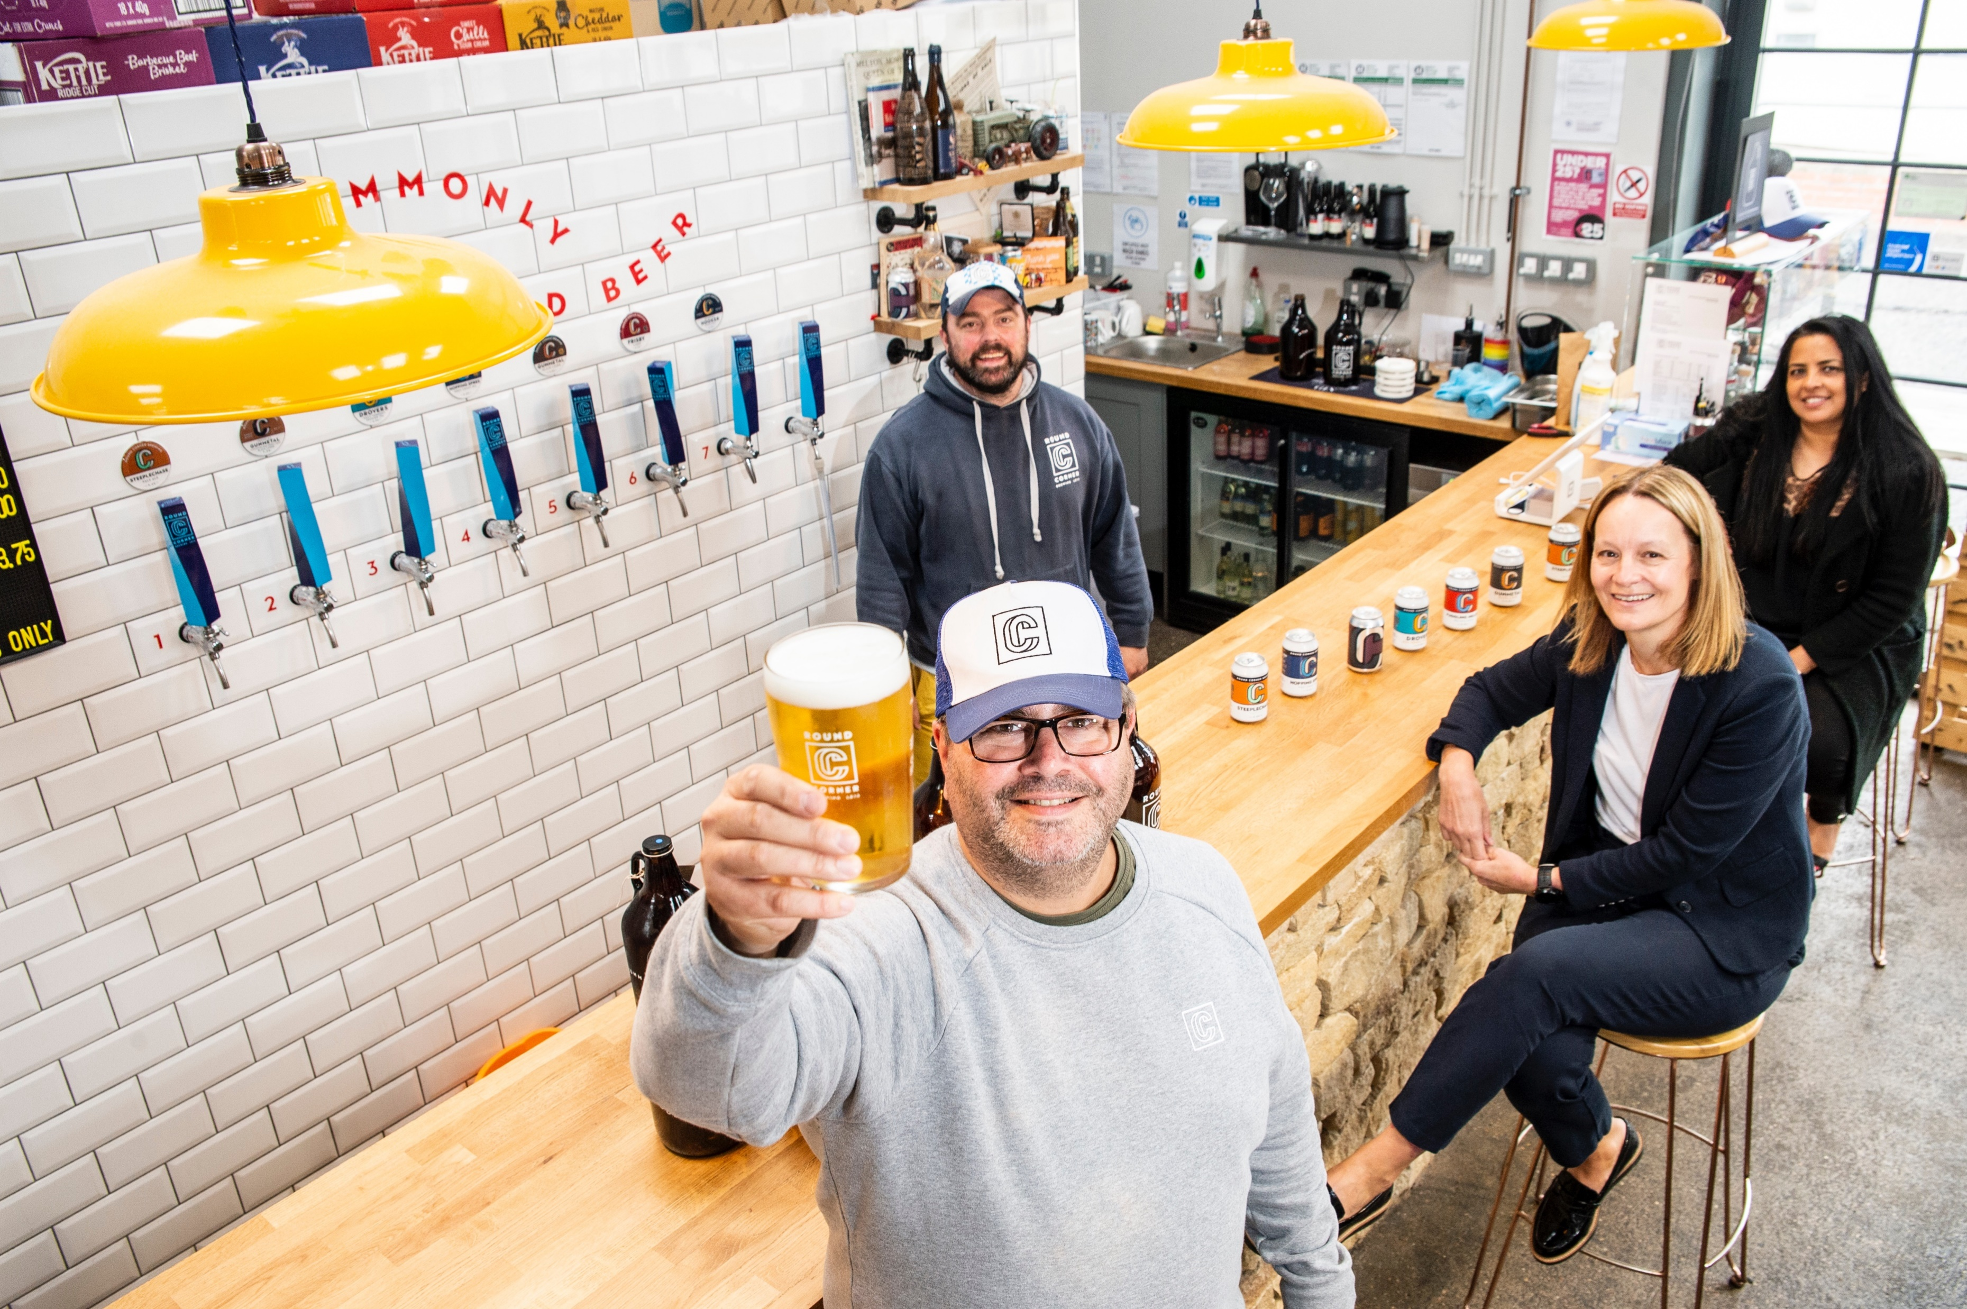
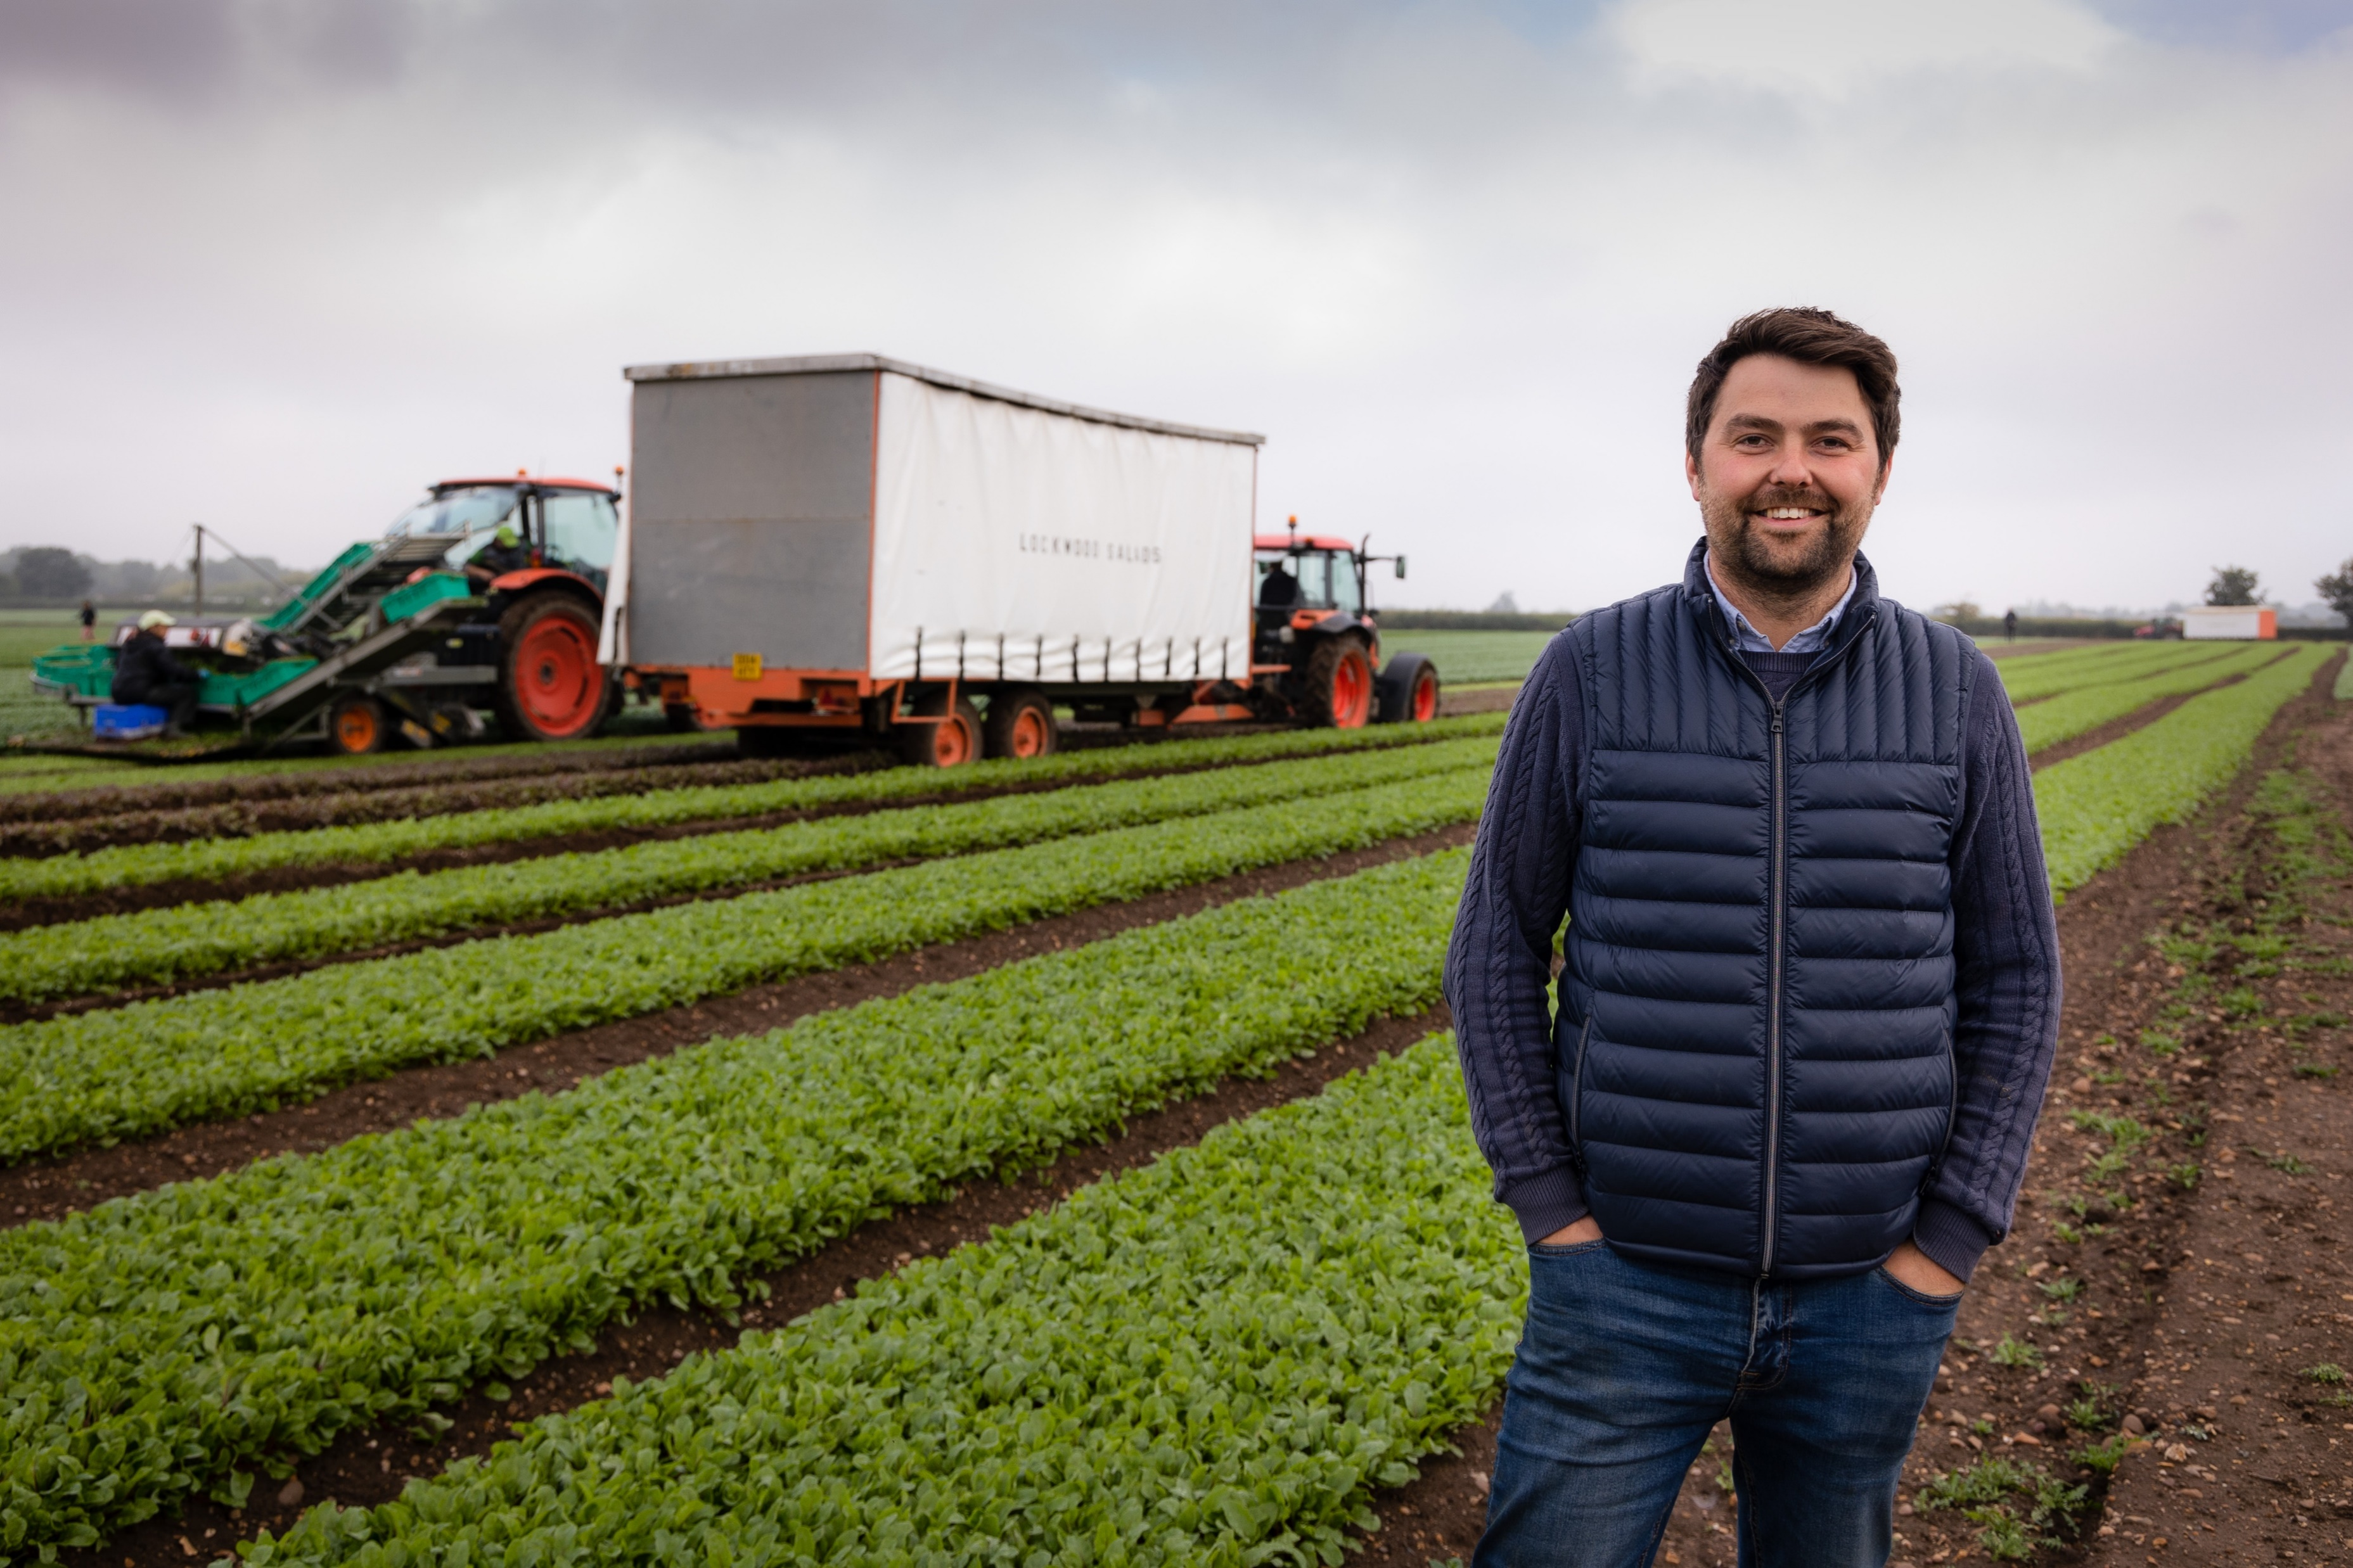
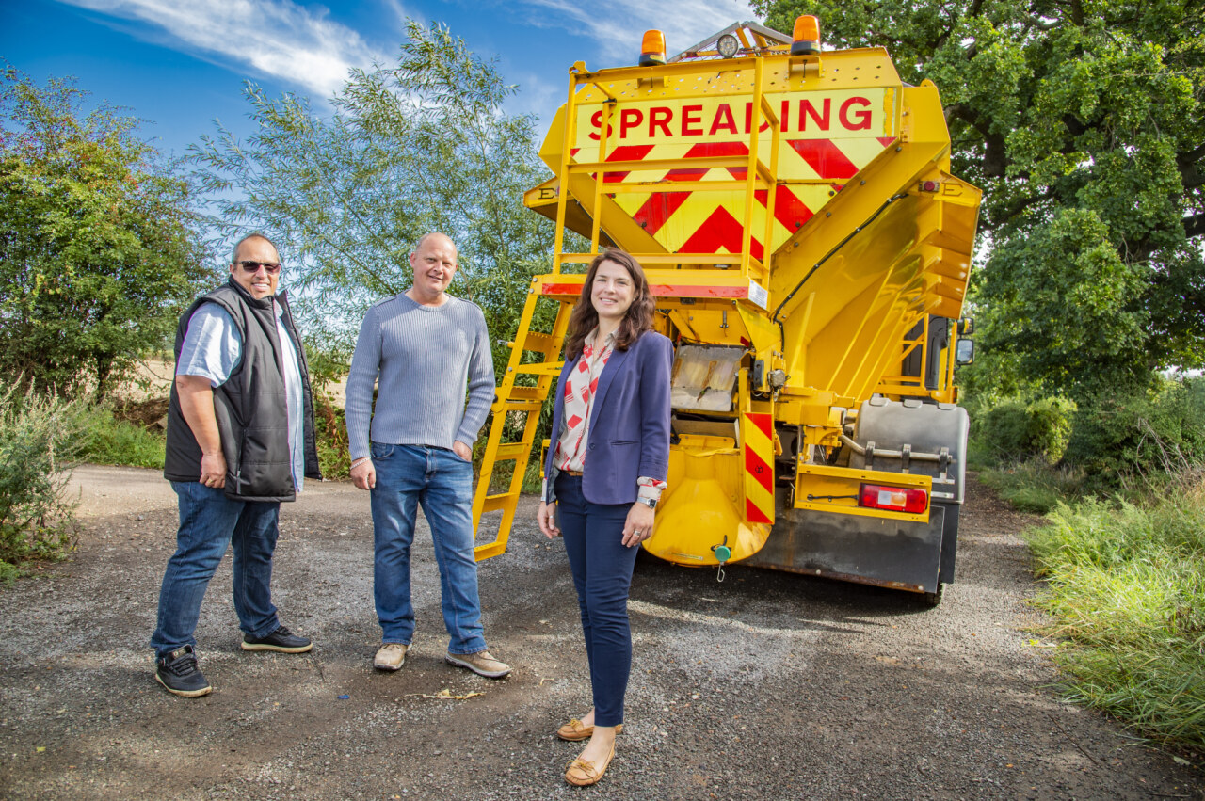
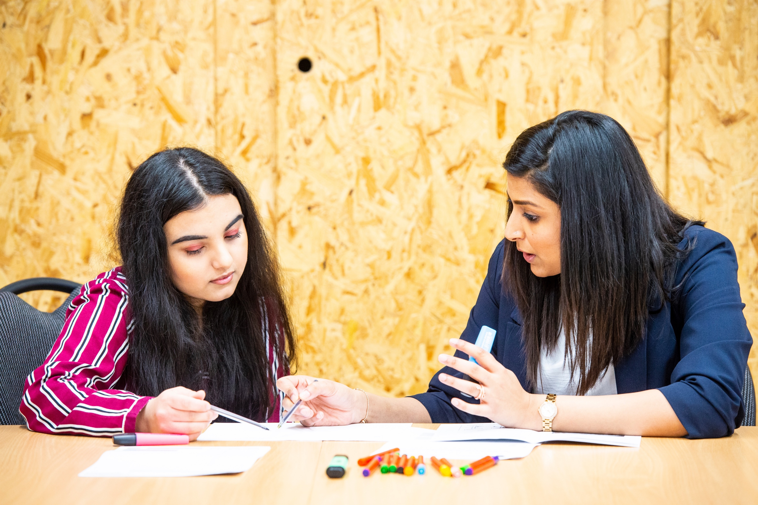
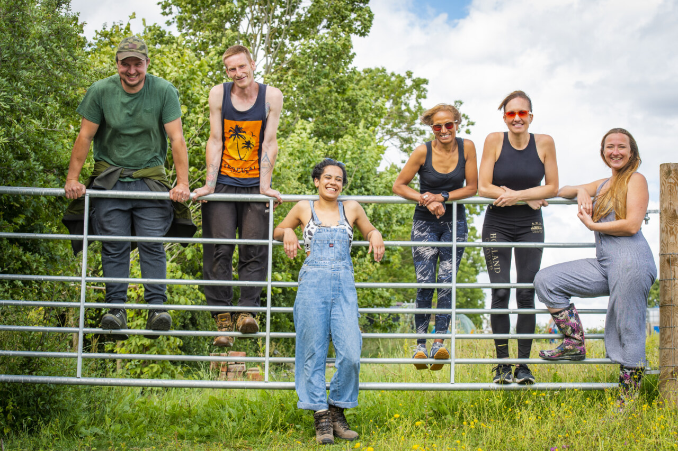

What Next?
Building On Our Success
Phoebe Dawson – CEO, Leicester & Leicestershire Enterprise Partnership

Slide 2
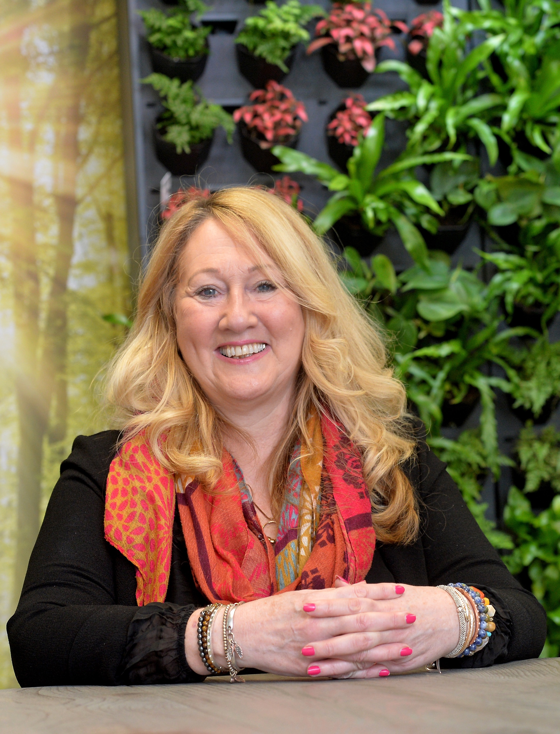
What are Growth Hubs?
Led by Local Enterprise Partnerships
Funded by Department of Business and Trade
Part of a strong national network
Promoting, co-ordinating, and delivering support
Designed to meet local need
DPI
North West Leicestershire

Slide 3
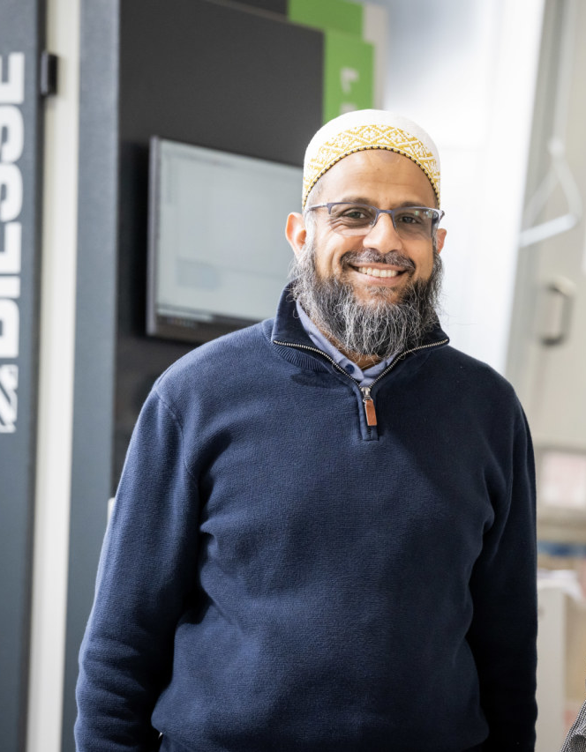
Our Purpose
To provide practical support for Leicester and Leicestershire businesses
To make use of our knowledge of funding and support programmes
To offer tailored support and guidance for businesses seeking advice, information, and funding
Interiors by Design
Oadby & Wigston

Slide 4
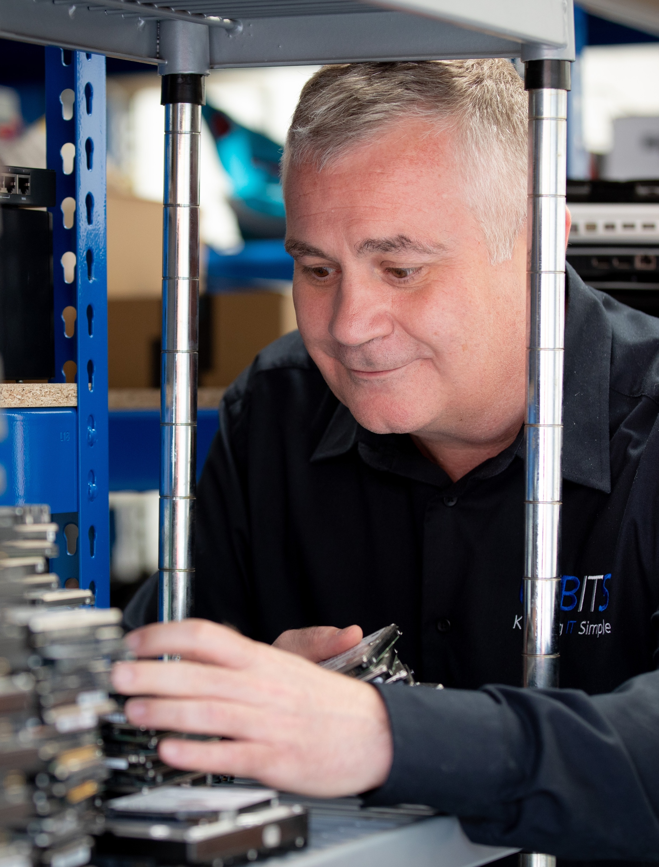
Our Future Role
One stop shop, signposting to business support
Central resource for economic data and funding opportunities
Collaborating with public and private sector partners to maximise opportunities
Promoting regional entrepreneurship
UK Bits
North West Leicestershire

Slide 5









How We Will Deliver It
Triage information
and signposting
Adviser support and network co-ordination
Events, webinars,
and workshops
Investment
readiness
High growth
support
Guidance on available support

Slide 6
Partnerships are key....

Slide 7

Working Together
  Business Gateway Growth Hub
  01164542917
  www.growthhub@bizgateway.org.uk
  Business Support Enquiry Form www.bizgateway.org.uk
Salma Manzoor
Partnerships & Growth Hub Manager

