Slide 1

Leicester City Council Business Support
Peter Chandler, Head of Economic Regeneration,
Leicester City Council
Notes:
Single point of access for business support via the Business Gateway, the Growth Hub for Leicester and Leicestershire.

Slide 2
Our role
To design and deliver business support projects and programmes across Leicester
To commission business support services from specialist organisations
To work closely with the Growth Hub as the primary access for business support
To collaborate with public and private sector partners to address need

Slide 3
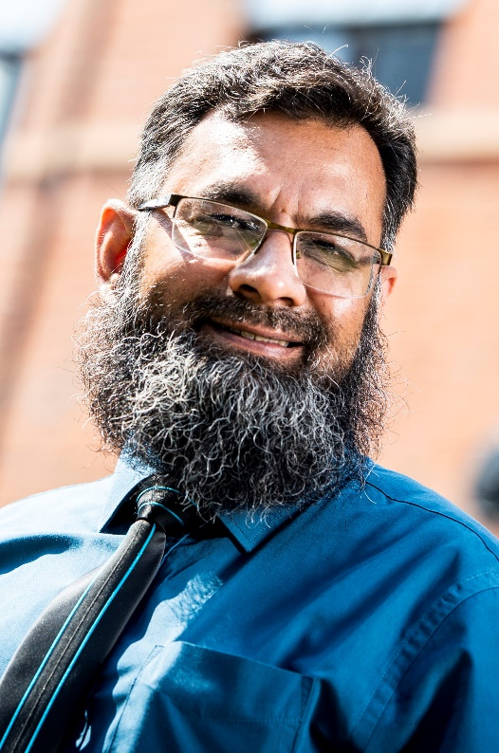
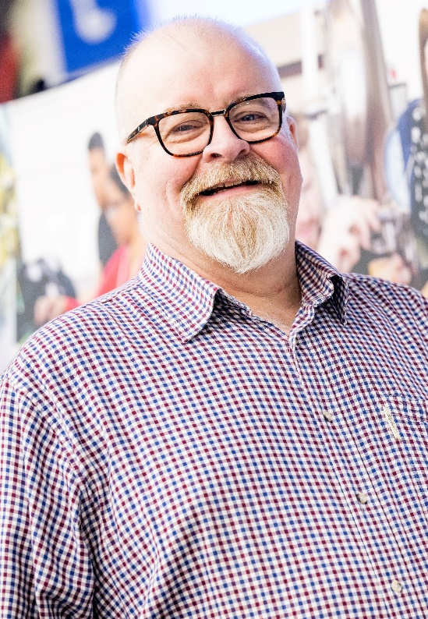
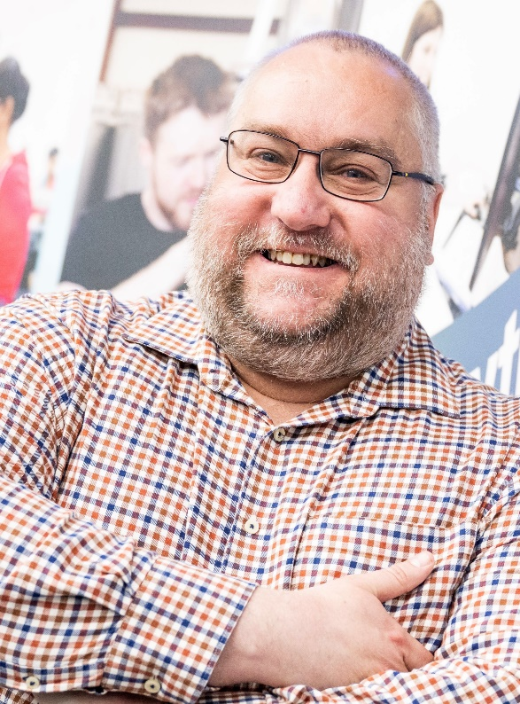
Business Advisers
Team of experienced advisers
Referrals from the Growth Hub and others

Slide 4
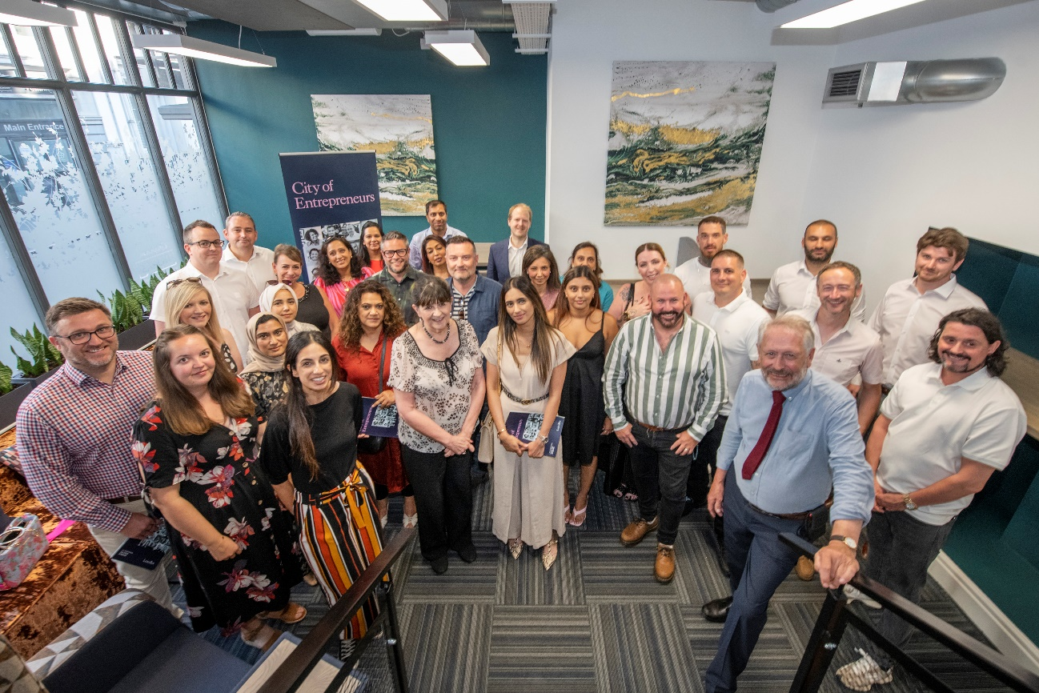
Business Support Delivery
Business advice and coaching
Sector support, including Creative and Digital/ Fashion and Textiles/ Visitor Economy
Linking with other relevant local, regional and national offers
Workspaces support programme
Skills and talent

Slide 5

UK Shared Prosperity Fund
End of European funding in 2023, replaced by UK Shared Prosperity Fund to March 2025
£3m allocated to Supporting Local Business
Complementary programmes for People and Skills and Local Communities

Slide 6
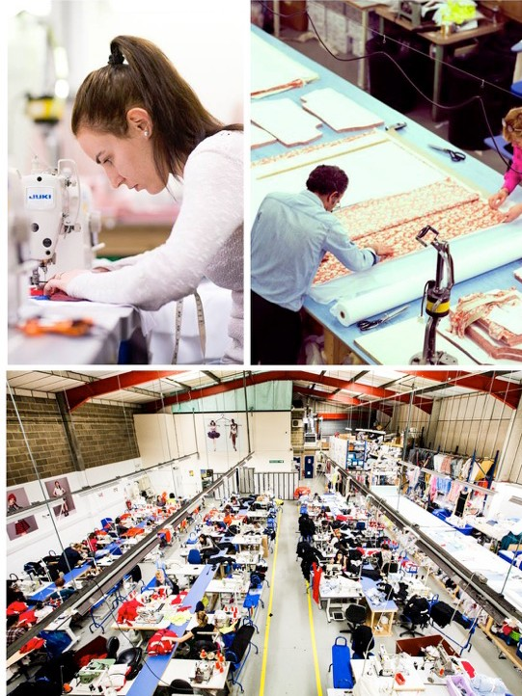
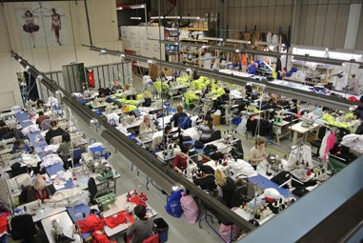
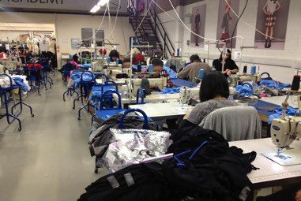
New programmes from late Summer 23
Business survival and growth
Peer network support
Net zero/ sustainability
Social enterprises

Slide 7
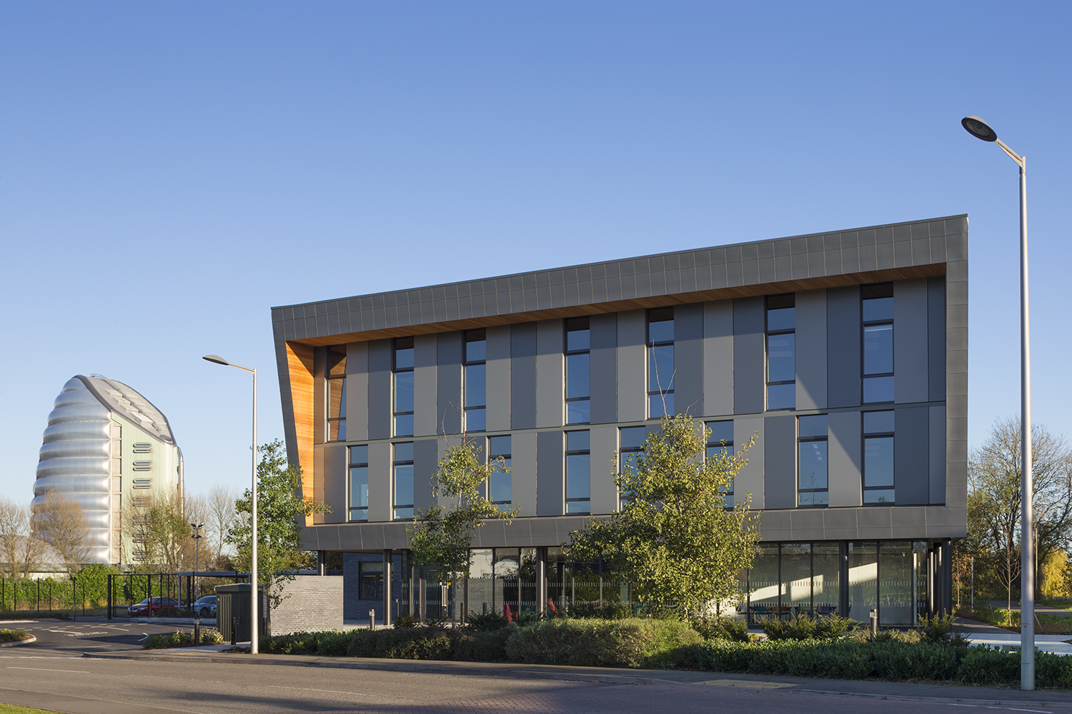
  Business Gateway Growth Hub 0116 454 2917
  Business Support Enquiry Form www.bizgateway.org.uk

